Slide 1

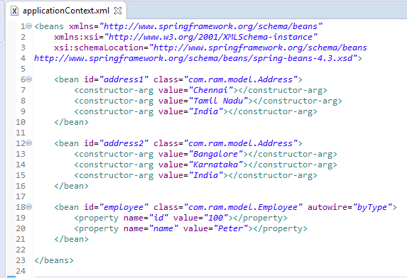
byType Auto-wiring mode in Spring
In case of byType auto-wiring mode, bean id and reference name may be different. But there must be only one bean of a type. It internally uses setter injection.
if you have multiple bean of one type, it will not work and throw exception

Slide 2
byType Auto-wiring mode in Spring
Caused by: org.springframework.beans.factory.NoUniqueBeanDefinitionException: No qualifying bean of type 'com.ram.model.Address' available: expected single matching bean but found 2: address1,address2
at org.springframework.beans.factory.config.DependencyDescriptor.resolveNotUnique(DependencyDescriptor.java:215)
at org.springframework.beans.factory.support.DefaultListableBeanFactory.doResolveDependency(DefaultListableBeanFactory.java:1113)
at org.springframework.beans.factory.support.DefaultListableBeanFactory.resolveDependency(DefaultListableBeanFactory.java:1062)
at org.springframework.beans.factory.support.AbstractAutowireCapableBeanFactory.autowireByType(AbstractAutowireCapableBeanFactory.java:1424)
... 14 more

